Slide 1
19AD784
IMAGE ANALYSIS AND COMPUTER VISION
Dr E Emerson Nithiyaraj
AP/ECE

Slide 2
2D Transforms
2D transforms are mathematical operations applied to two-dimensional objects (such as images, shapes, or coordinate systems) to change their position, orientation, size, or shape.
The 2D Discrete Fourier Transform (DFT) is a powerful tool in image processing and signal analysis.
It converts a spatial domain representation of a 2D signal (such as an image) into its frequency domain representation.
This transformation allows for the analysis and manipulation of the image's frequency components, which can be useful for filtering, compression, and other applications.

Slide 3
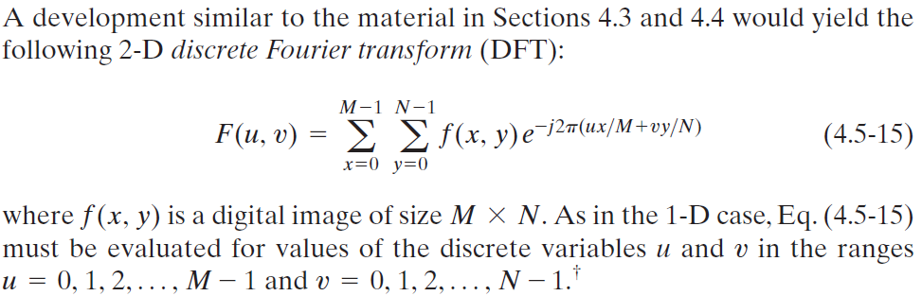
2D Discrete Fourier Transform (DFT)
The term frequency in an image tells about the rate of change of pixel values.

Slide 4
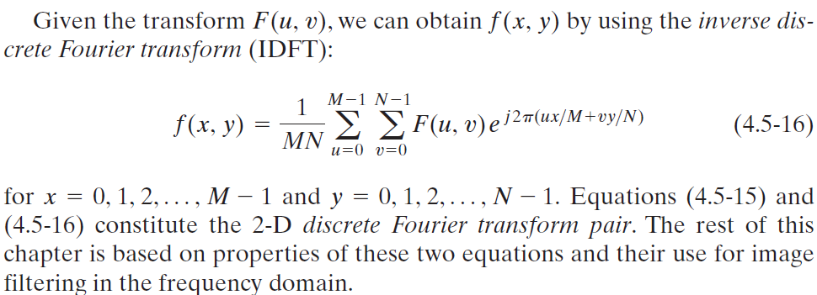
2D Inverse Discrete Fourier Transform (DFT)

Slide 5
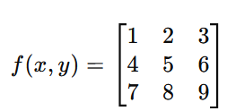
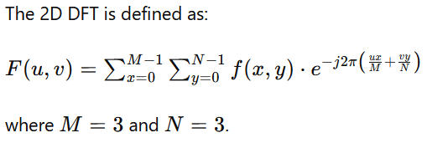
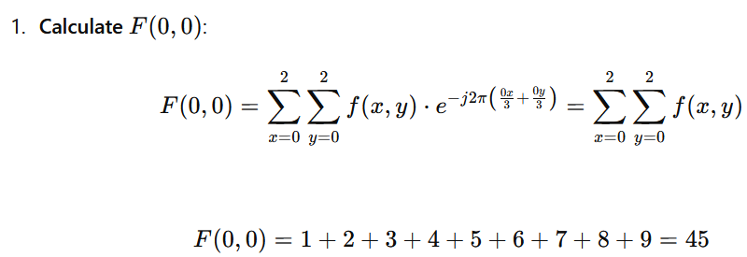

Slide 6
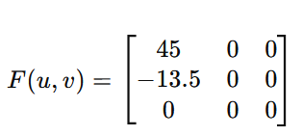
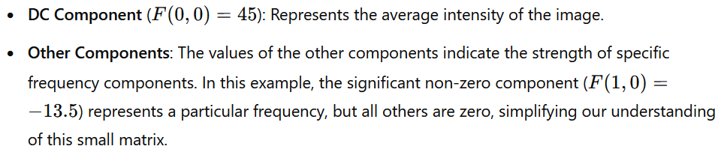

Slide 7
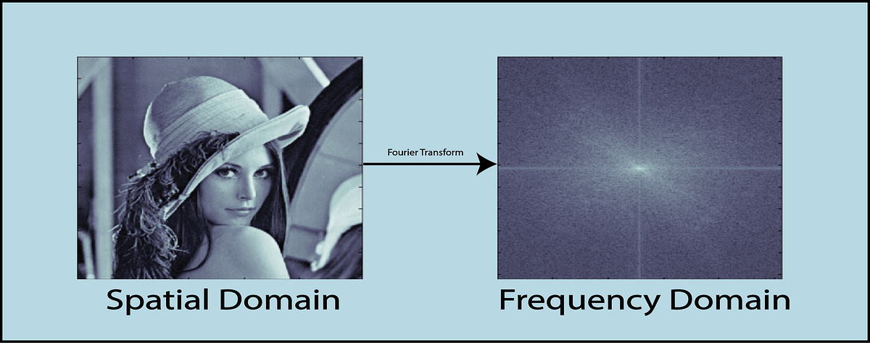

Slide 8
Low-Frequency Components:
Low Frequencies: These are slow changes in the image. Imagine a gentle gradient from dark to light.
Large, Smooth Variations: These are the big, smooth areas of an image, where there isn't much detail or many sharp edges. Think of a clear blue sky or a plain wall.
Center of the Frequency Domain Image: The very middle of the frequency domain image represents these low-frequency components. It shows the overall structure or the basic shapes and gradients in the image.

Slide 9
Visualizing Low Frequencies:
If you look at the frequency domain image, the center is where you see information about these smooth, broad areas.
Brightness at the center indicates how strong these overall smooth patterns are in the original image.
The frequency domain image is like a visual equalizer for your photo, showing how much bass and treble (low and high frequencies) there are.

Slide 10
High-Frequency Components:
High Frequencies: These are fast changes in the image. Imagine sharp transitions or lots of little details.
Rapid Changes: These occur where the image changes quickly from one color or brightness to another, like the edges of objects.
Edges or Corners of the Frequency Domain Image: The outer parts of the frequency domain image represent these high-frequency components.

Slide 11
Visualizing High Frequencies:
If you look at the frequency domain image, the edges or corners show information about the fine details and sharp transitions in the image.
Bright spots away from the center indicate strong edges or textures in the original image.

Slide 12
Brightness in the Frequency Domain Image:
The brightness of each point in the frequency domain image indicates the strength (or amplitude) of that particular frequency component.
Brighter spots mean that those frequencies are more prominent in the original image.
A very bright center means that the image has strong overall (low-frequency) components, while bright spots away from the center indicate strong edges or fine details.

Slide 13
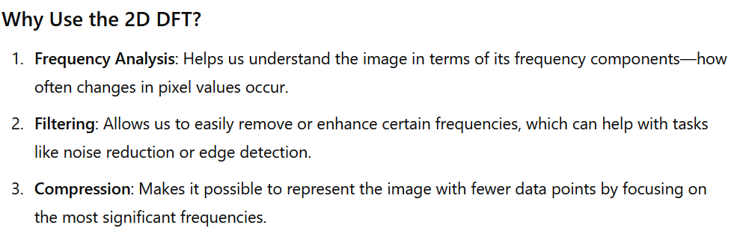

Slide 14
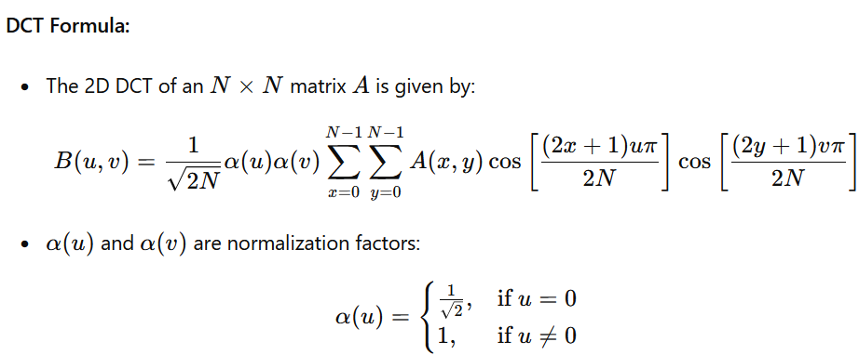
2D Discrete Cosine Transform (DCT)
The DCT represents an image as a sum of cosine functions oscillating at different frequencies.
These cosine functions are called basis functions.
Each basis function represents a specific frequency pattern.

Slide 15
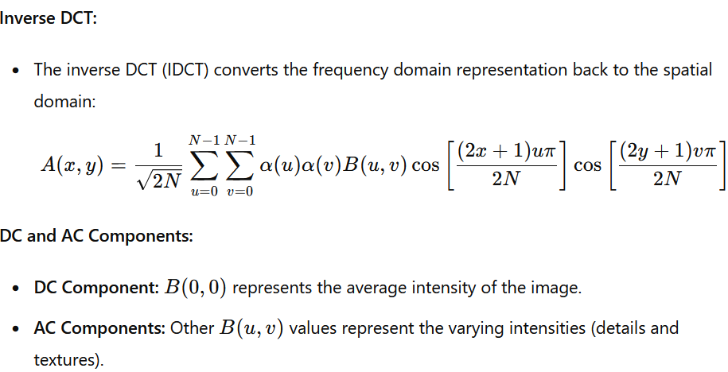
2D Discrete Cosine Transform (DCT)

Slide 16
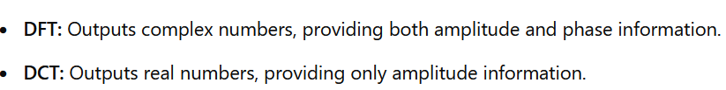
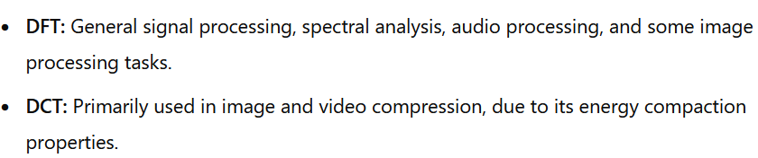
DFT vs. DCT

